Slide 1
Learning Objective
I will be able to determine the equation of tangents and normal at a given point on a graph
Success Criteria
At the end of the lesson, I will be able to:
Determine the equation of tangents at a given point on a graph
Define normal to a curve at a point on the curve
Determine the equation of the normal at a given point on a graph

Slide 2
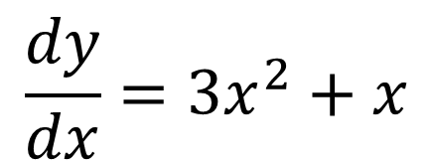
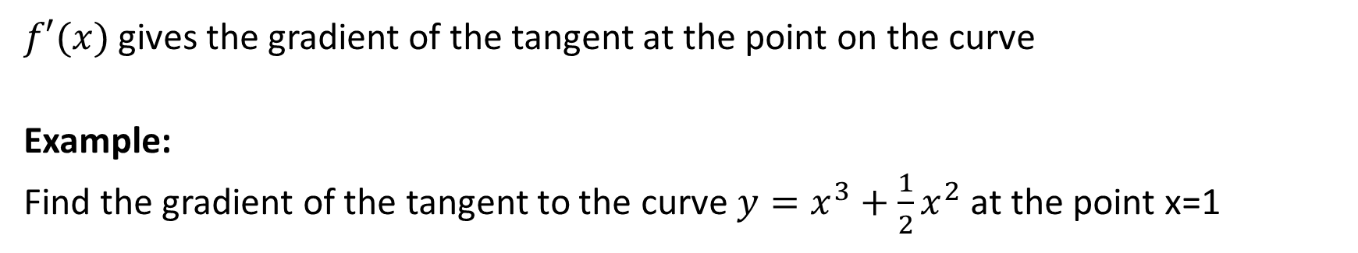
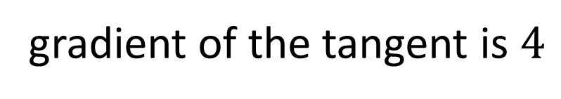
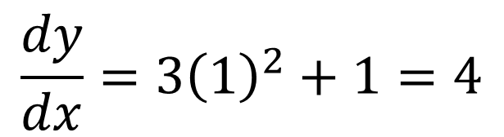
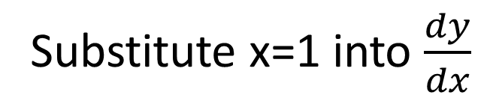
Concept Development
$f′(x)$ gives the gradient of the tangent at the point on the curve
Example:
Find the gradient of the tangent to the curve $y=x^{3}+\frac{1}{2}x^{2}$ at the point x=1
$$\frac{dy}{dx}=3x^{2}+x$$
Substitute x=1 into $\frac{dy}{dx}$
$$\frac{dy}{dx}=3{\left(1\right)}^{2}+1=4$$
gradient of the tangent is $4$

Slide 3
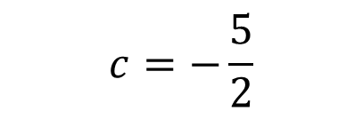
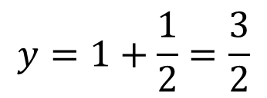
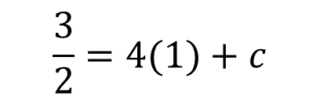
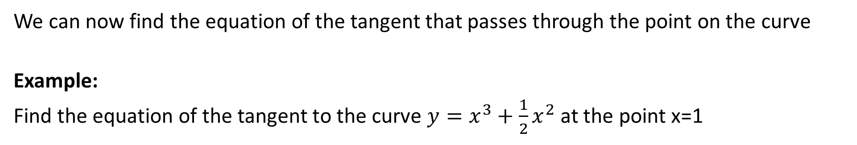
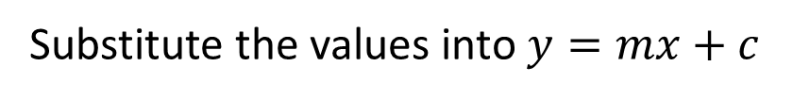

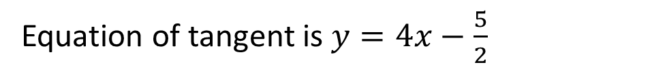
Concept Development
We can now find the equation of the tangent that passes through the point on the curve
Example:
Find the equation of the tangent to the curve $y=x^{3}+\frac{1}{2}x^{2}$ at the point x=1
Find the coordinate at x=1
$$y=1+\frac{1}{2}=\frac{3}{2}$$
Now, find the equation of the line with gradient m=4, passing through $\left(1,\frac{3}{2}\right)$
$$y=mx+c$$
Substitute the values into $y=mx+c$
$$\frac{3}{2}=4(1)+c$$
$$c=−\frac{5}{2}$$
Equation of tangent is $y=4x−\frac{5}{2}$

Slide 4


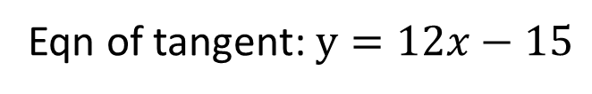

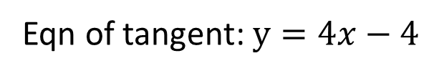







Guided Practice
Differentiate the equation
Expand the equation
$$f^{′}\left(x\right)=2x$$
$$f\left(x\right)=4x^{2}−4x+1$$
Find the gradient of tangent at point (2,4)
Differentiate the equation
$$f^{′}\left(2\right)=2\left(2\right)=4$$
$$f^{′}\left(x\right)=8x−4$$
Find the gradient of tangent at point (2,9)
Substitute m=4, points (2,4) into y=mx+c
$$f^{′}\left(2\right)=8\left(2\right)−4=12$$
$$4=4\left(2\right)+c$$
Substitute m=12, points (2,9) into y=mx+c
$$c=−4$$
$$9=12\left(2\right)+c$$
$$c=−15$$
Eqn of tangent: $y=4x−4$
Eqn of tangent: $y=12x−15$

Slide 5
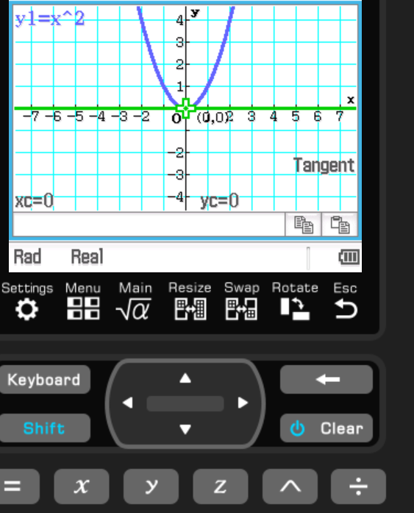

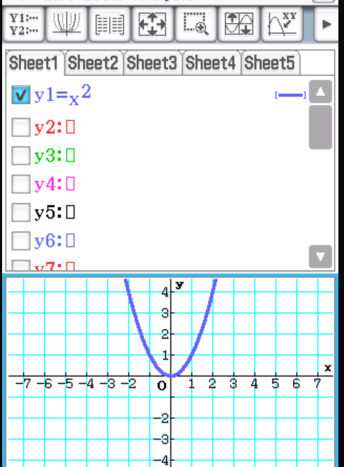
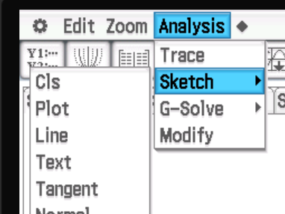
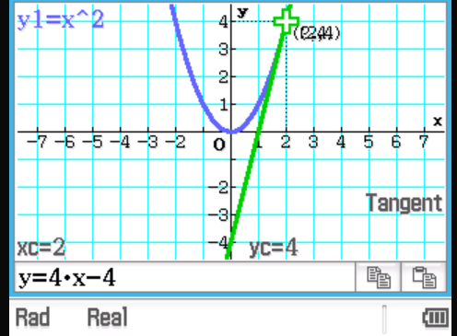
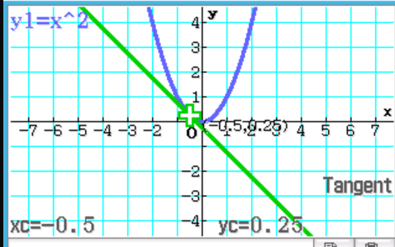
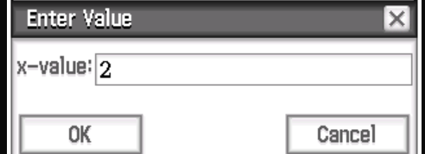
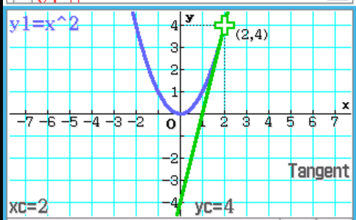
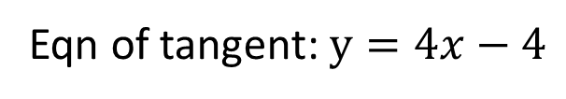
Using ClassPad
Eqn of tangent: $y=4x−4$

Slide 6
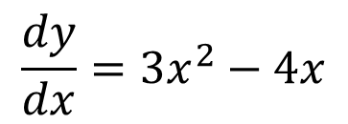
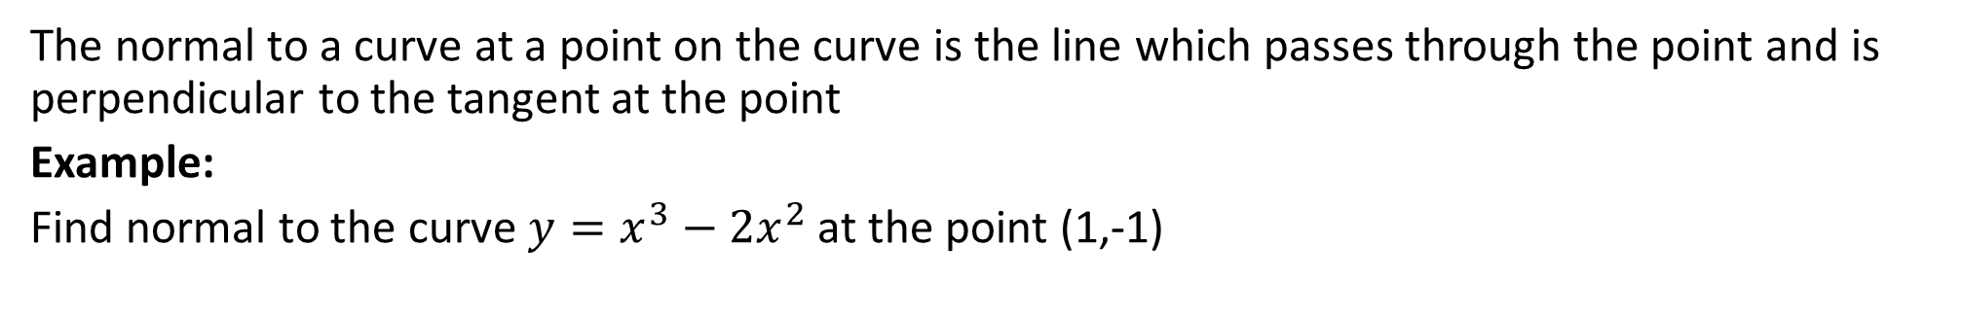
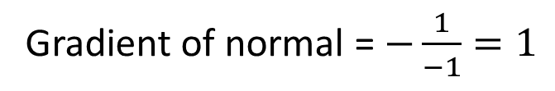

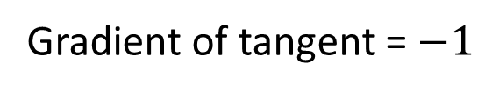
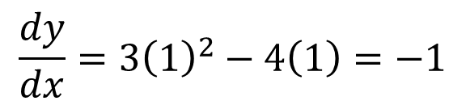

Concept Development
The normal to a curve at a point on the curve is the line which passes through the point and is perpendicular to the tangent at the point
Example:
Find normal to the curve $y=x^{3}−2x^{2}$ at the point (1,-1)
$$\frac{dy}{dx}=3x^{2}−4x$$
Find the gradient at point (1, -1)
$$\frac{dy}{dx}=3{\left(1\right)}^{2}−4\left(1\right)=−1$$
Gradient of tangent = $−1$
Gradient of normal = $−\frac{1}{−1}=1$
Substitute m=1, points (1,-1) into -1=(1)(1)+c
$$c=−2$$
$$y=x−2$$

Slide 7
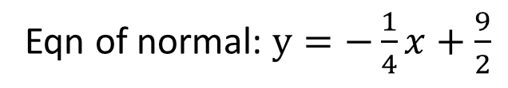
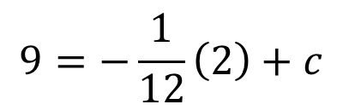
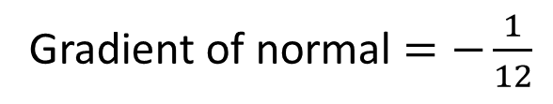
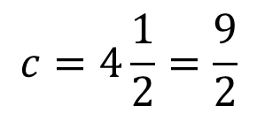
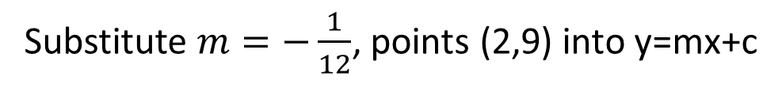
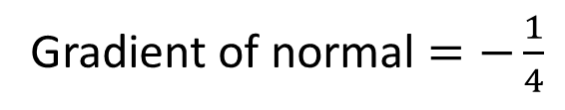
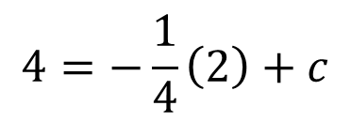

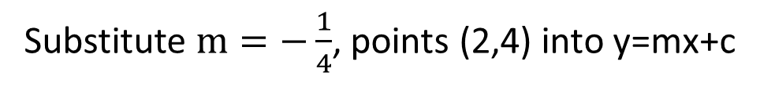
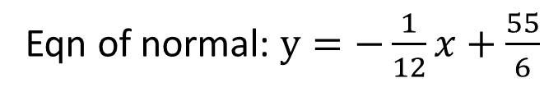


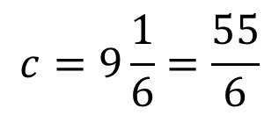
Guided Practice
Expand the equation
Differentiate the equation
$$f^{′}\left(x\right)=2x$$
$$f\left(x\right)=4x^{2}−4x+1$$
Differentiate the equation
Find the gradient of tangent at point (2,4)
$$f^{′}\left(x\right)=8x−4$$
$$f^{′}\left(2\right)=2\left(2\right)=4$$
Find the gradient of tangent at point (2,9)
Gradient of normal $=−\frac{1}{4}$
$$f^{′}\left(2\right)=8\left(2\right)−4=12$$
Gradient of normal $=−\frac{1}{12}$
Substitute $m=−\frac{1}{4}$, points (2,4) into y=mx+c
Substitute $m=−\frac{1}{12}$, points (2,9) into y=mx+c
$$4=−\frac{1}{4}\left(2\right)+c$$
$$9=−\frac{1}{12}\left(2\right)+c$$
$$c=4\frac{1}{2}=\frac{9}{2}$$
$$c=9\frac{1}{6}=\frac{55}{6}$$
Eqn of normal: $y=−\frac{1}{4}x+\frac{9}{2}$
Eqn of normal: $y=−\frac{1}{12}x+\frac{55}{6}$

Slide 8
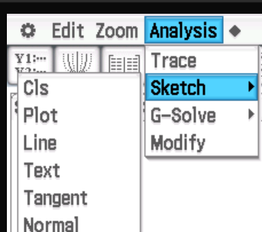
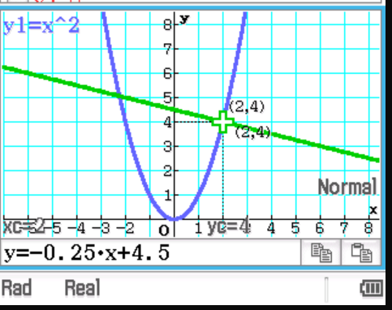
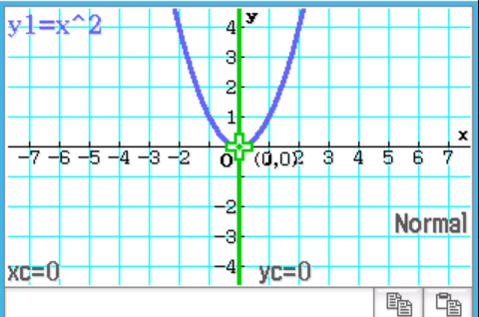
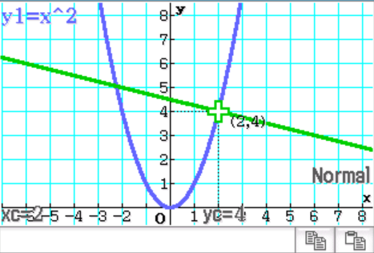
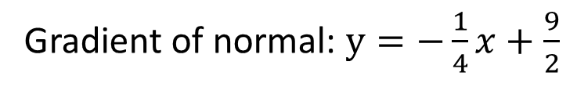
Using ClassPad
Gradient of normal: $y=−\frac{1}{4}x+\frac{9}{2}$

Slide 9
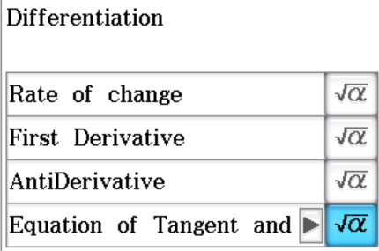
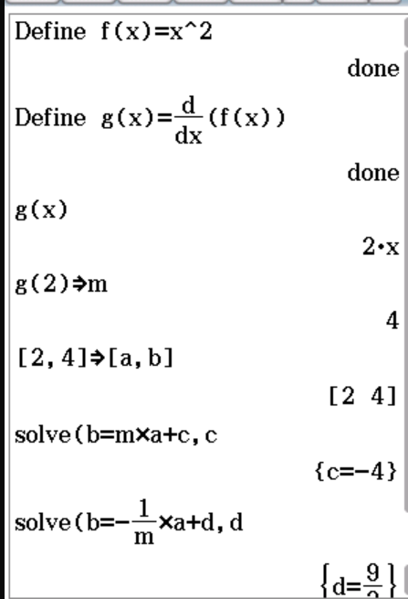
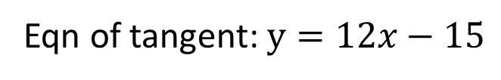
Using ClassPad
Eqn of tangent: $y=4x−4$
Eqn of tangent: $y=12x−15$

Slide 10
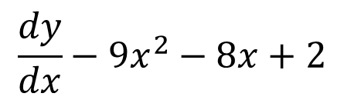
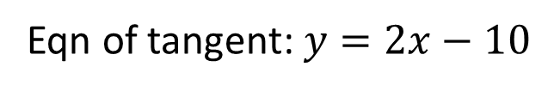

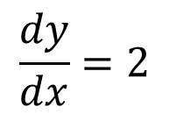
Guided Practice
Differentiate the equation
$$\frac{dy}{dx}−9x^{2}−8x+2$$
Find the gradient of tangent at point (0,-10)
$$\frac{dy}{dx}=2$$
Substitute m=2, points (0,-10) into y=mx+c
$$c=10$$
Eqn of tangent: $y=2x−10$

Slide 11


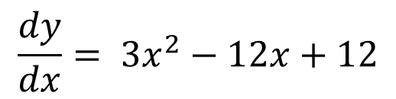

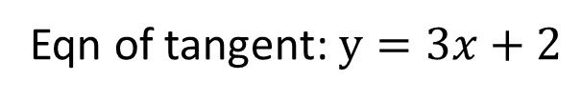

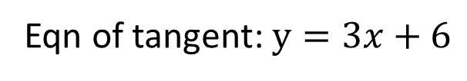





Guided Practice
Differentiate the equation
$$\frac{dy}{dx}= 3x^{2}−12x+12$$
Gradient of tangent needs to be $\frac{dy}{dx}= 3$, solve for x values
$$3x^{2}−12x+12=3$$
Substitute $x=3 and 1$ into y
$$y={\left(1\right)}^{3}−6{\left(1\right)}^{2}+12\left(1\right)+2=9$$
$$3x^{2}−12x+9=0$$
$$y={\left(3\right)}^{3}−6{\left(3\right)}^{2}+12\left(3\right)+2=11$$
$$3\left(x−3\right)\left(x−1\right)=0$$
Substitute $m=3$, points (1,9) into y=mx+c
Eqn of tangent: $y=3x+6$
Substitute $m=3$, points (3,11) into y=mx+c
$$x=3,1$$
Eqn of tangent: $y=3x+2$

Slide 12














Guided Practice
Differentiate the equation
Rearrange the equation
$$\frac{dy}{dx}=3x^{2}−18x+20$$
$$y=−4x+3$$
Substitute $\frac{dy}{dx}=−4$ solve for x
Find the gradient of tangent at point (1,4)
$$\frac{dy}{dx}=3{\left(1\right)}^{2}−18\left(1\right)+20=5$$
$$3x^{2}−18x+20=−4$$
Substitute m=5, points (1,4) into y=mx+c
$$3\left(x−2\right)\left(x−4\right)=0$$
$$x=2, x=4$$
$$4=5\left(1\right)+c$$
Substitute into first equation, $x=2, x=4$
$$c=−1$$
$$y={\left(2\right)}^{3}−9{\left(2\right)}^{2}+20\left(2\right)−8=4$$
Equation of tangent: $y=5x−1$
$$y={\left(4\right)}^{3}−9{\left(4\right)}^{2}+20\left(4\right)−8=−8$$
$$(2,4), (4,−8)$$

Slide 13





Guided Practice
Expand the equation
$$y=x^{3}−9x^{2}+26x−24$$
$$\frac{dy}{dx}=3x^{2}−18x+26$$
Substitute point P (2,0) to find gradient of tangent at P
$$\frac{dy}{dx}=3{\left(2\right)}^{2}−18\left(2\right)+26=2=m_{1}$$
Substitute point R (4,0) to find gradient of tangent at R
$$\frac{dy}{dx}=3{\left(4\right)}^{2}−18\left(4\right)+26=2=m_{2}$$
Since $m_{1}=m_{2}$ therefore the two tangents are parallel

Slide 14





Guided Practice
Expand the equation
$$y=x^{3}−9x^{2}+26x−24$$
$$\frac{dy}{dx}=3x^{2}−18x+26$$
Substitute point Q (3,0) to find gradient of tangent at Q
$$\frac{dy}{dx}=3{\left(3\right)}^{2}−18\left(3\right)+26=−1$$
Gradient to normal $=−\frac{1}{−1}=1$
Substitute $m=1$, points (3,0) into y=mx+c
$$c=−3$$
Coordinates of y-intercept: $\left(0,−3\right)$

Slide 15
Independent Practice
Complete Cambridge Ex 18A

